Slide 1
Introduction
Dr. Pramod Kumar Maurya
Assistant Professor (Senior)
School of Computer Science & Engineering
Mo.:09643322724

Slide 2
Types of programming languages (based on programming difficulty)
Low level (closer to machine code in 0’s & 1’s)
– Machine language
– Assembly Language
High level (like human languages)
– C, C++ (can say these are mid-level)
– Python

Slide 3
Types of programming languages based on paradigm
POP (Procedure oriented programming) language
– C
OOP (Object-oriented programming) language
– C++
– Python

Slide 4
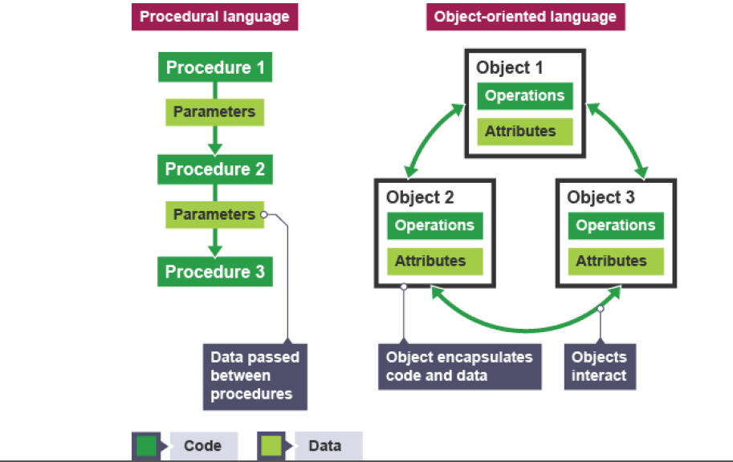

Slide 5
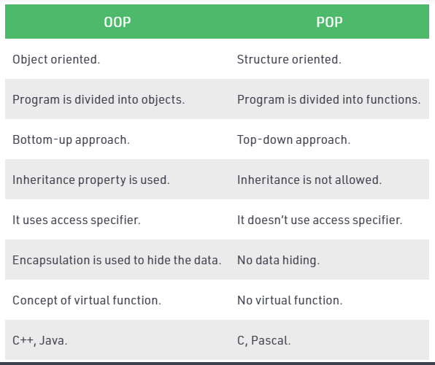
Difference between OOP and POP

Slide 6
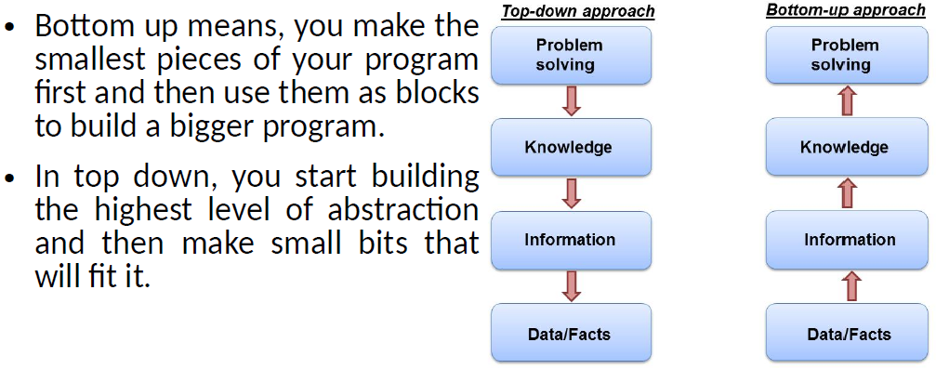
Top-down vs Bottom up approaches

Slide 7
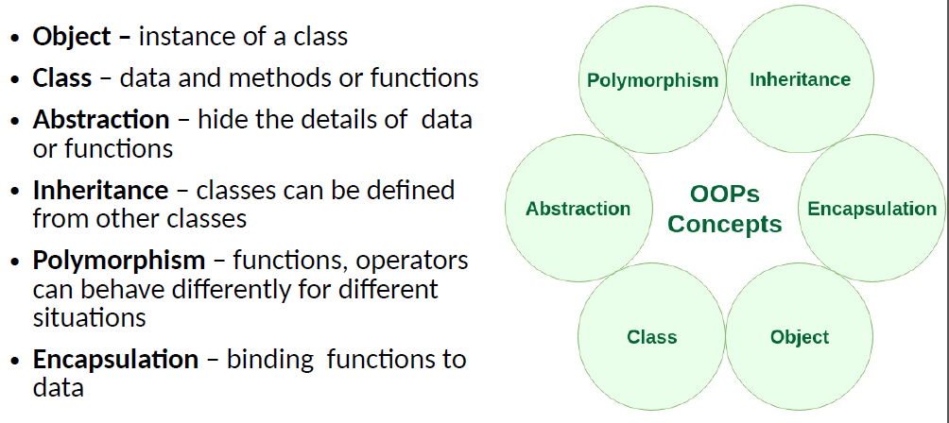
OOP

Slide 8
Class
The building block of C++ that leads to Object-Oriented programming is a Class. It is a user-defined data type, which holds its own data members and member functions, which can be accessed and used by creating an instance of that class. A class is like a blueprint for an object.

Slide 9
Object
An Object is an identifiable entity with some characteristics and behaviour. An Object is an instance of a Class. When a class is defined, no memory is allocated but when it is instantiated (i.e. an object is created) memory is allocated.

Slide 10
Encapsulation
Encapsulation is defined as wrapping up of data and information under a single unit. In Object-Oriented Programming, Encapsulation is defined as binding together the data and the functions that manipulate them.

Slide 11
Abstraction
Data abstraction is one of the most essential and important features of object-oriented programming. Abstraction means displaying only essential information and hiding the details.

Slide 12
Polymorphism
The word polymorphism means having many forms. In simple words, we can define polymorphism as the ability of a message to be displayed in more than one form.

Slide 13
Inheritance
The capability of a class to derive properties and characteristics from another class is called Inheritance.

